Slide 1

Activities we are involved with

Slide 2
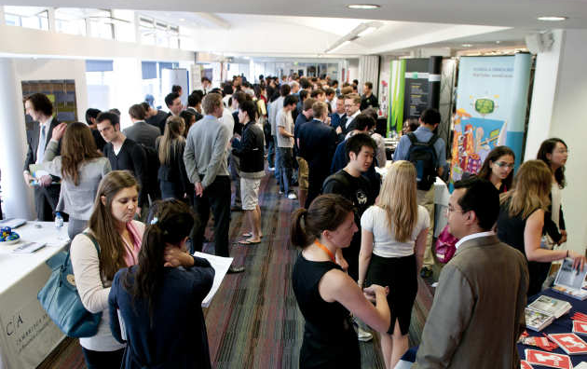

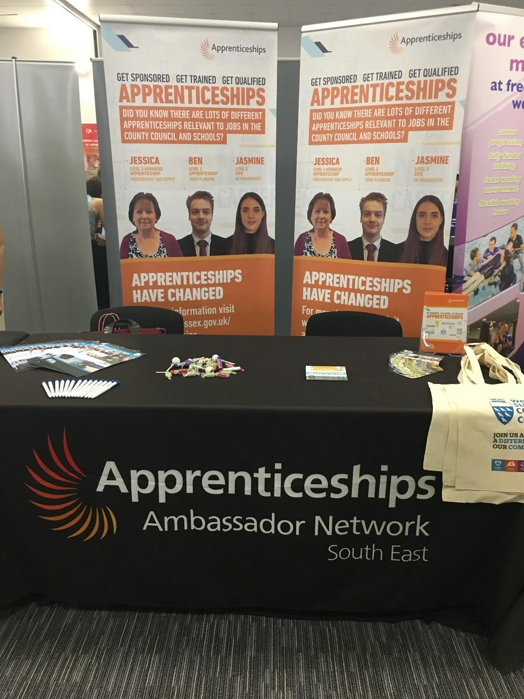
School and careers events
Employer talks
Industrial visits
Interview techniques
CV writing support
Assemblies
Work experience and taster days
This Photo by Unknown Author is licensed under CC BY

Slide 3
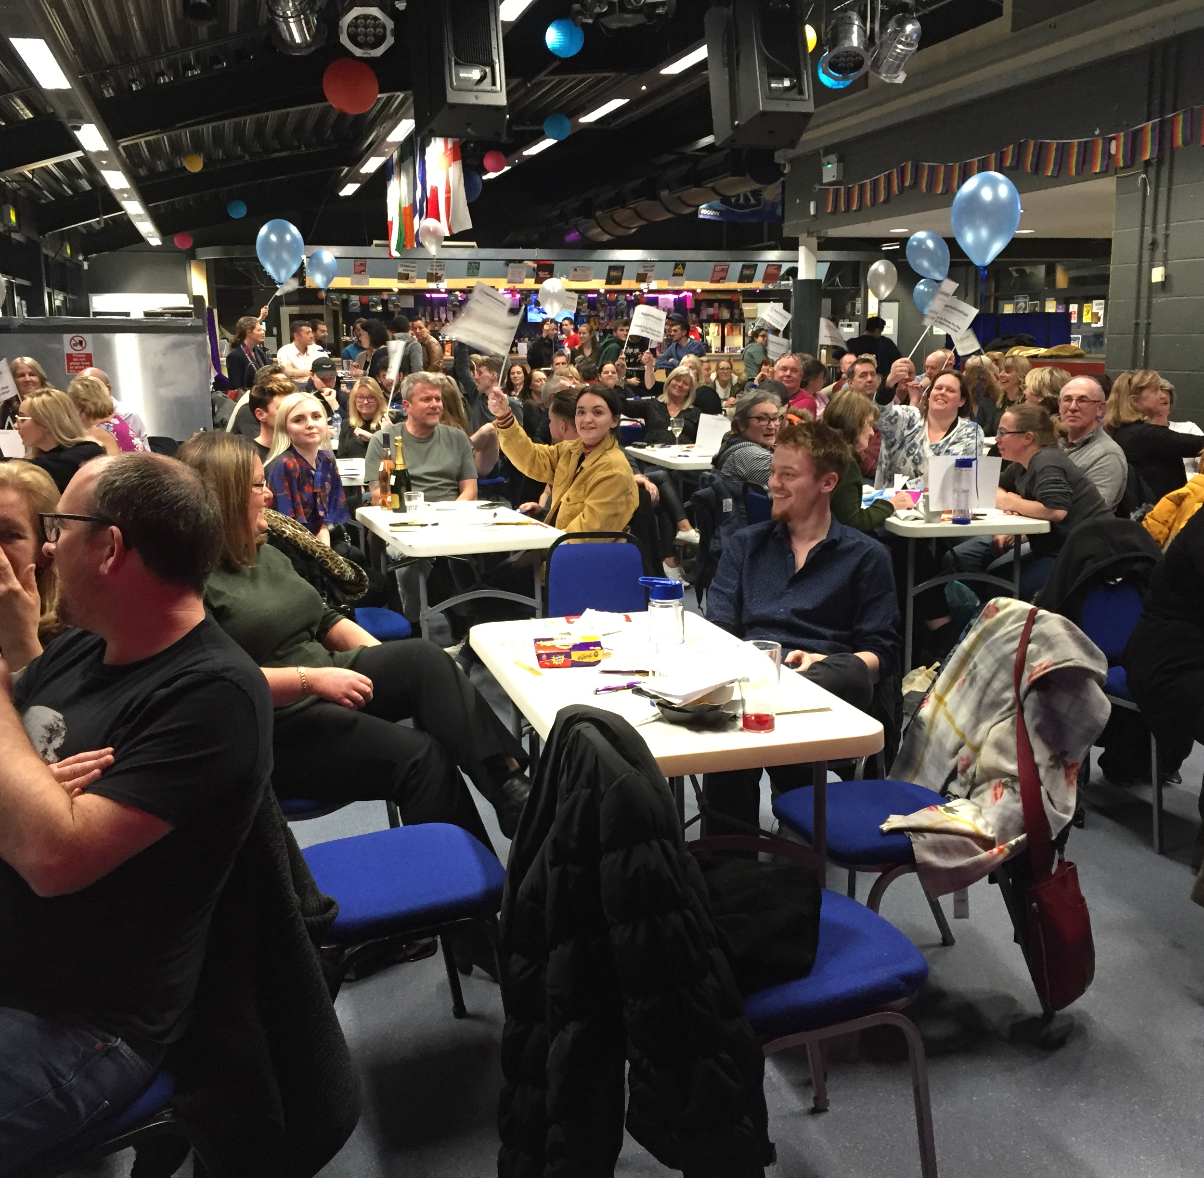
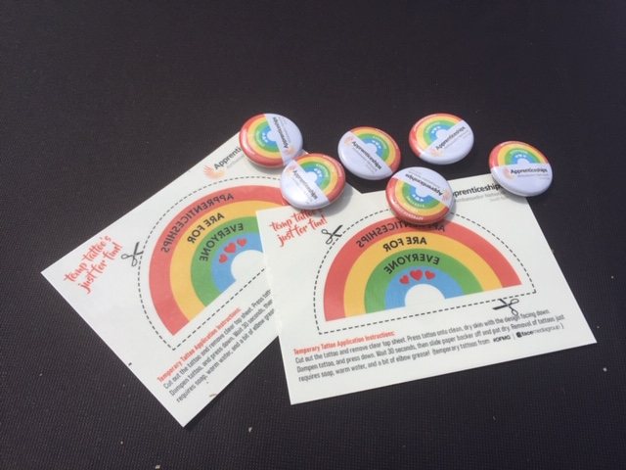
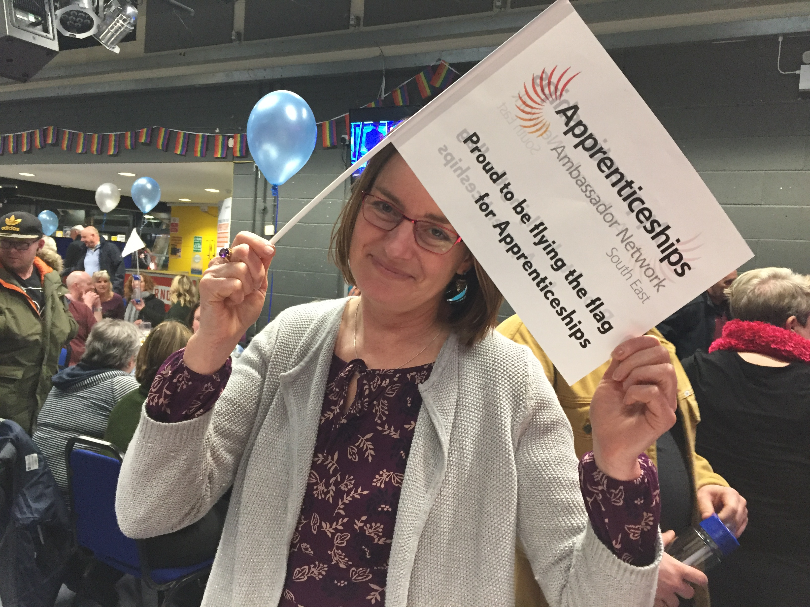
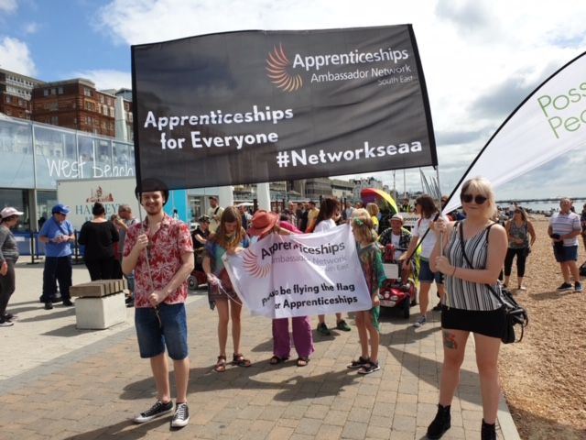

Sponsorship and Supporting Apprenticeship events and celebrations
Local and National Award Ceremonies
Government promotional events eg T levels and Apprenticeships
National Apprenticeship Week activities eg Sponsorship of Apprenticeship Charity Quiz Night and ‘ Flying the Flag’ competition.
Link with local MPs and Apprenticeship MP Ambassador for support and PR
Disability Pride Brighton 2019
Provision of Apprenticeship graduation badges and temporary tattoos for promotional events

Slide 4

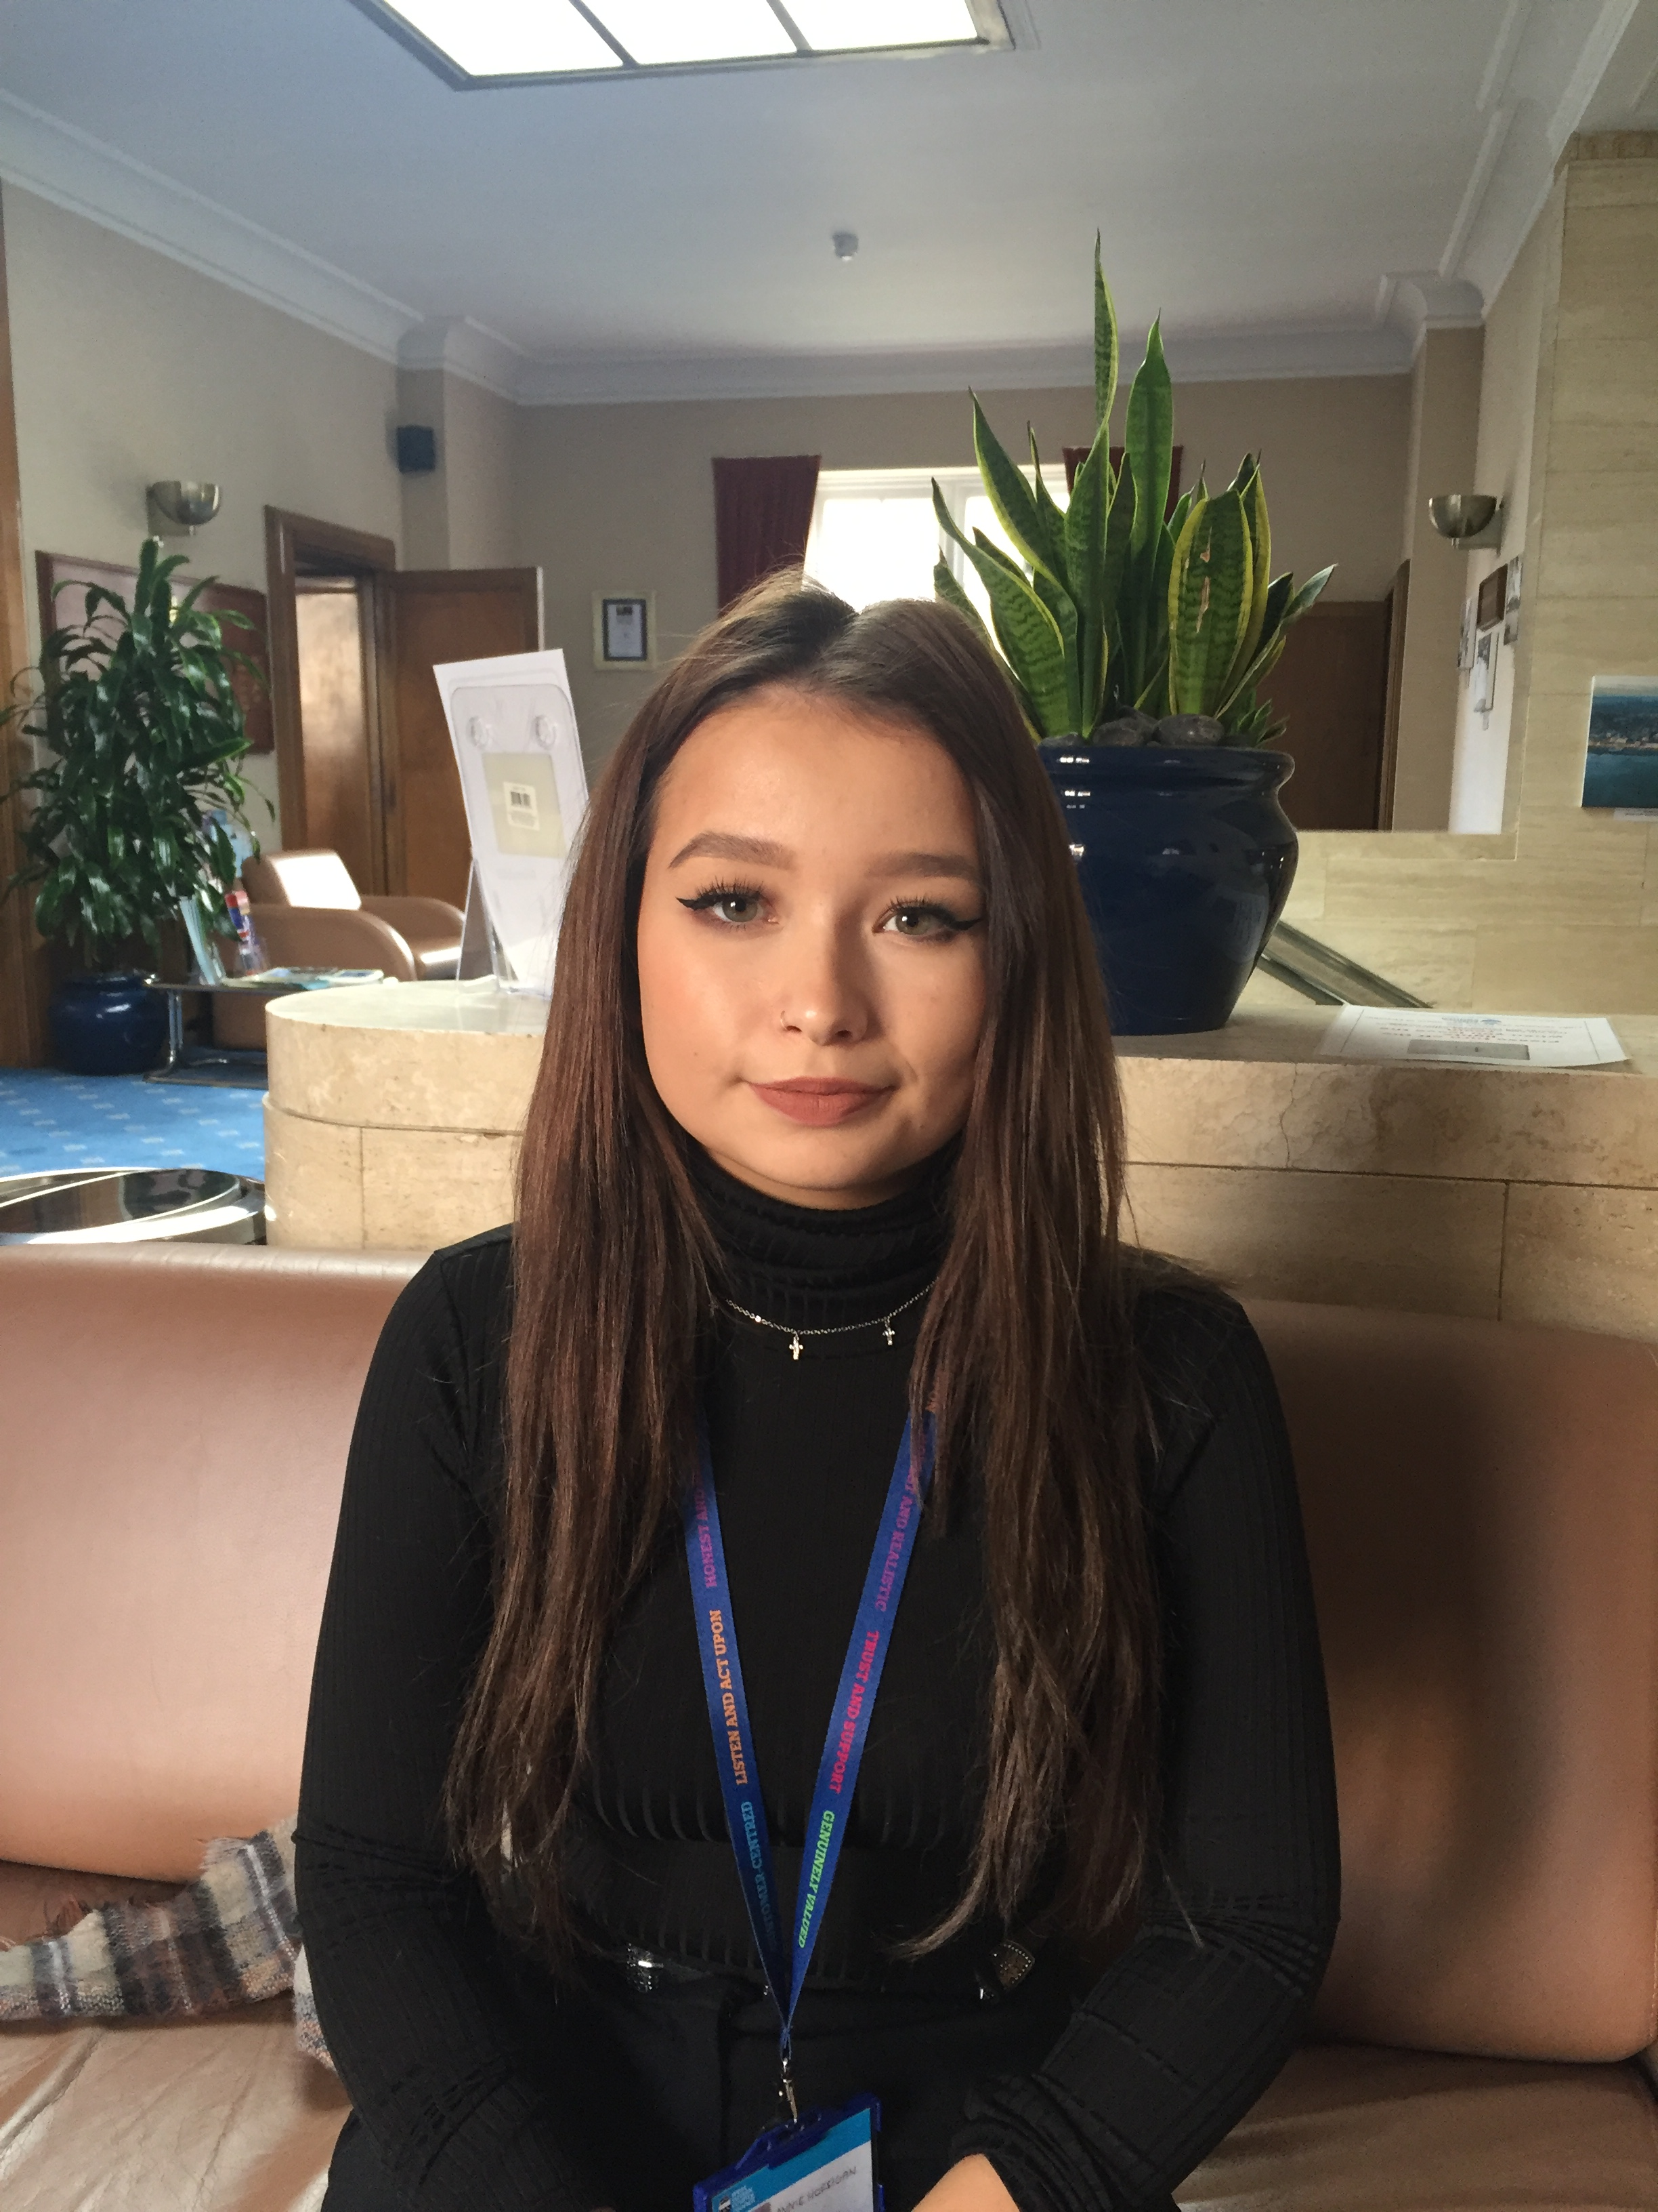
Providing case studies and promotional materials
Creation of regional Apprenticeship news and media stories
Crafting Apprenticeship and Employer case studies
Sponsorship of Degree Apprenticeship promotional film
Employer information leaflets and powerpoint presentations

Slide 5

Promotion of Apprenticeships through Social Media
Expansion of AAN footprint on twitter and Linked In.
165 followers on twitter:
@NetworkSeaa
72 connections on Linked In:
SE Apprenticeship Ambassador Network
Coming next: SE AAN website currently under construction

Slide 6
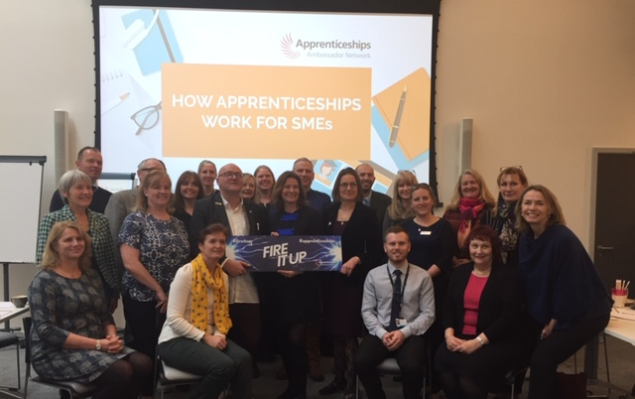
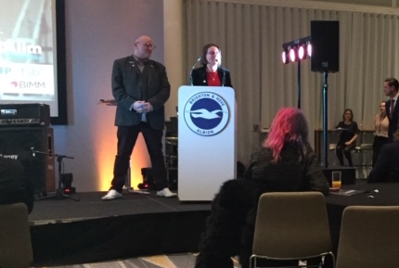
Advocacy to employers new to Apprenticeships
Examples:
1:1 support
Group support
Links with local FSB and Chambers of Commerce
Levy transfer guidance
Increasing our membership. Currently 69 active Ambassadors.
Encouraging employers to promote the Young Apprenticeship Ambassador Network (YAAN) to their own Apprentices

Slide 7

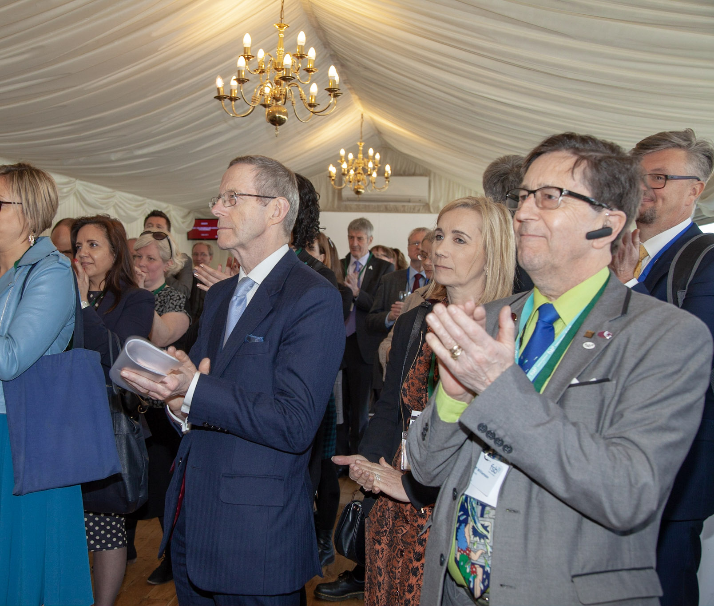
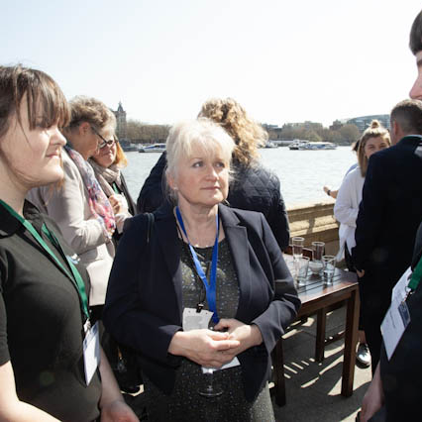
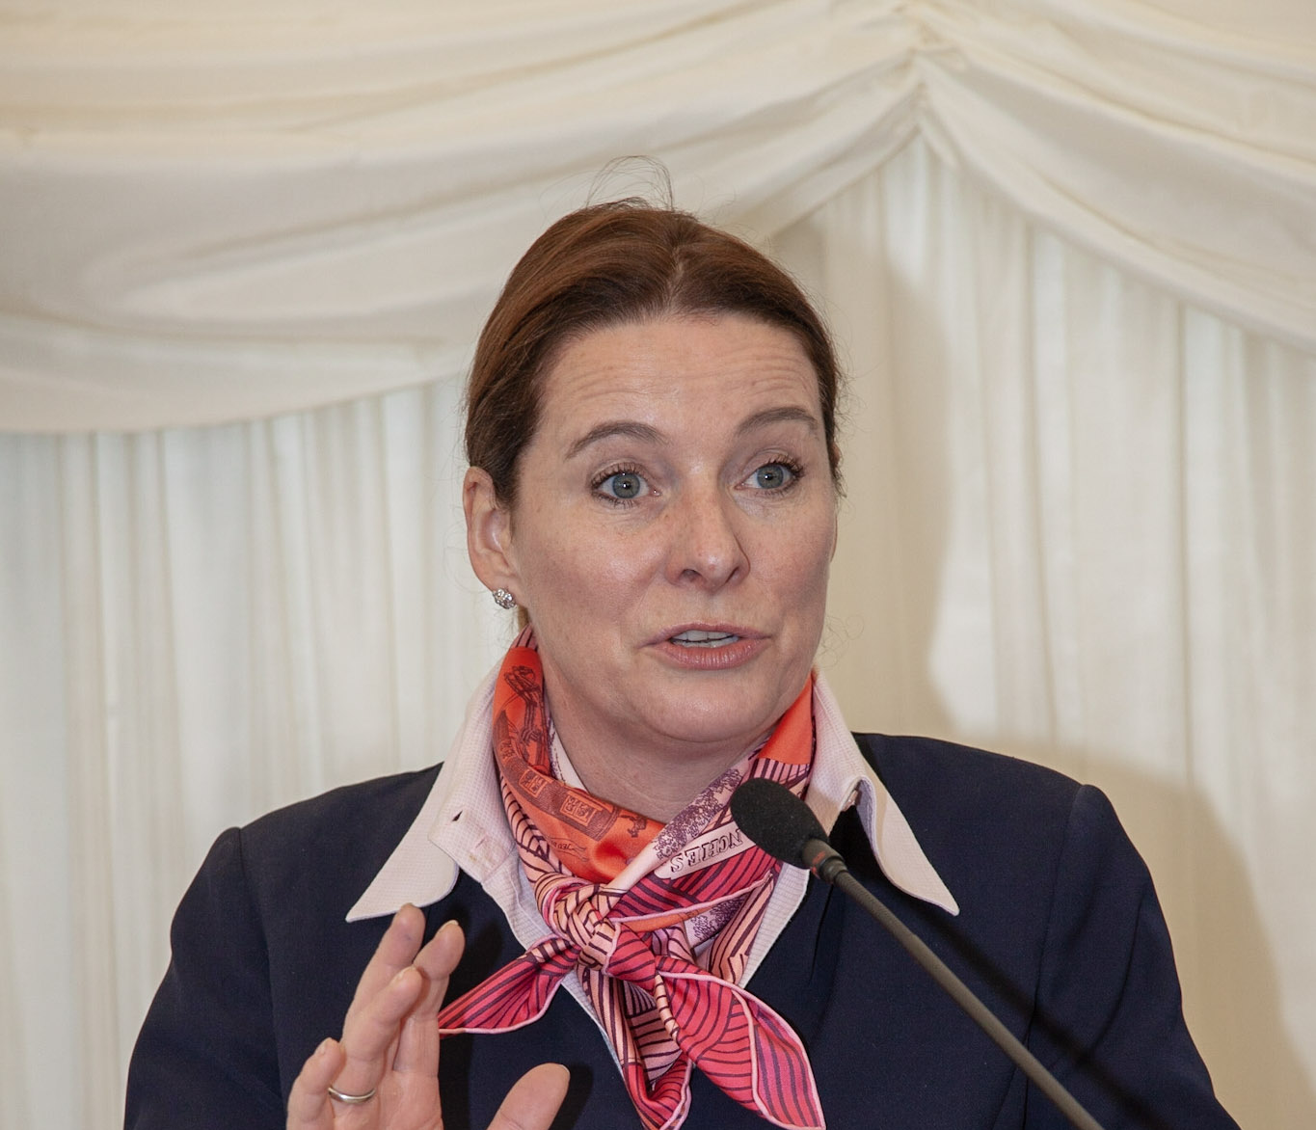
Providing insight to government departments on all things Apprenticeships.
Feeding back employer views on Apprenticeships, Traineeships, T levels, levy transfers
Lobbying MPs
Participation in ESFA consultations
Involvement with new Standard developments
Sharing good practice within the network eg 20% OTJ training, using the Apprenticeship Service

Slide 8
Providing insight to government departments on all things Apprenticeships.
Feeding back employer views on Apprenticeships, Traineeships, T levels, levy transfers
Lobbying MPs
Participation in ESFA consultations
Involvement with new Standard developments
Sharing good practice within the network eg 20% OTJ training, using the Apprenticeship Service

Slide 9
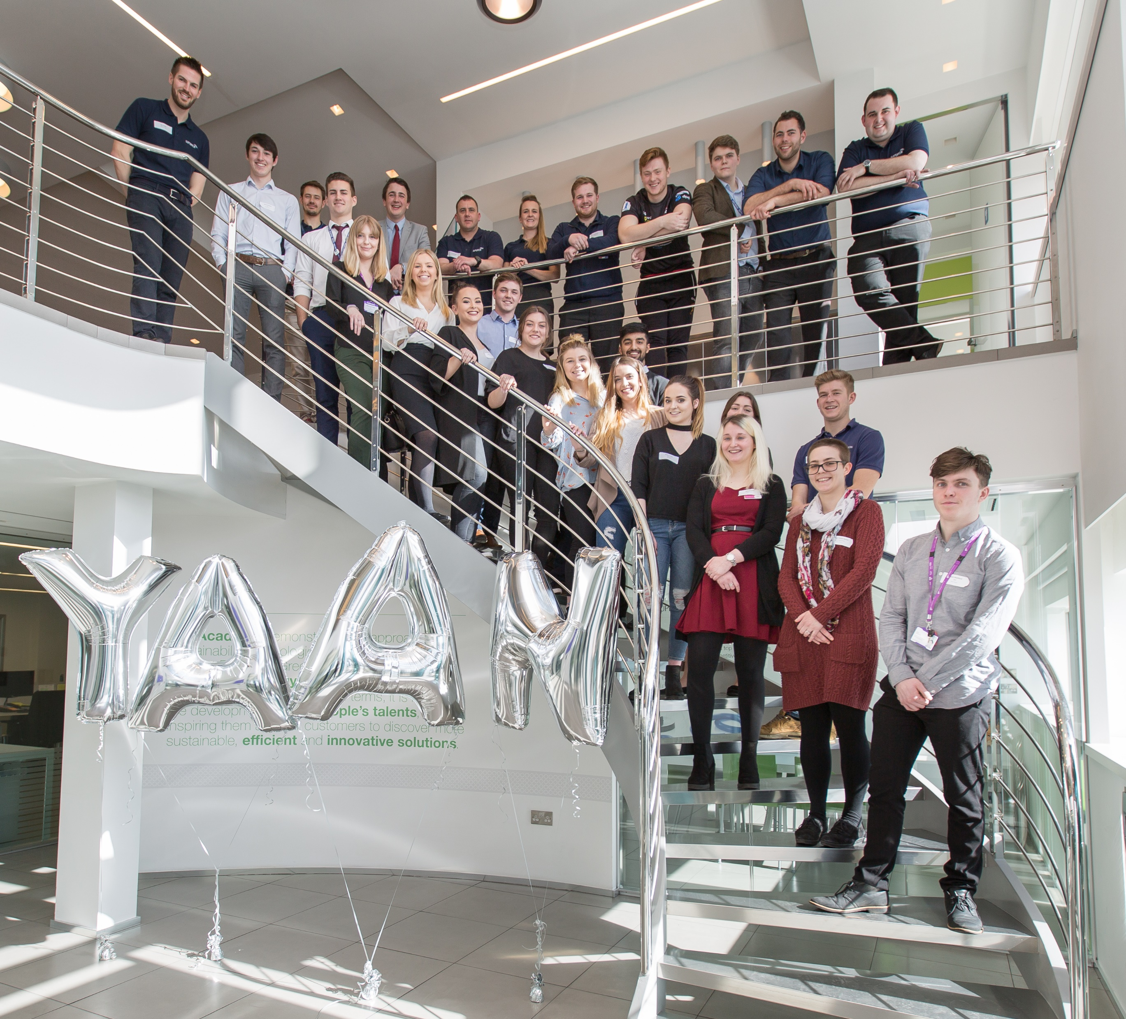
Providing a strategic link with the SE Young Apprenticeship Ambassador network
SouthEast YAAN
178 Young Apprenticeship Ambassadors in the SE.
Focus is on attending school and career events to promote Apprenticeships
Used as promotional case studies
Activities can be counted as part of 20% OTJ training if they can be linked to behaviour, knowledge and skills of the Standard.

