Slide 1
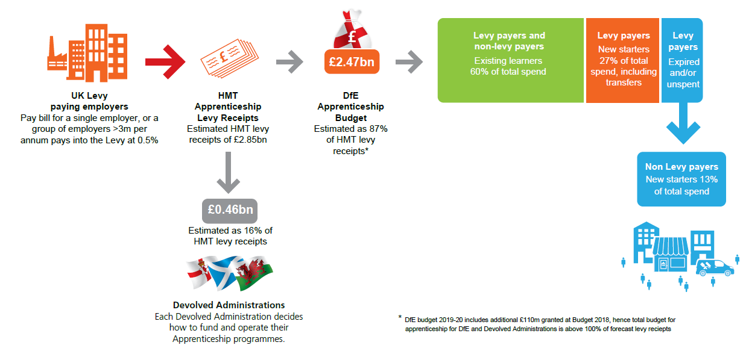
How the money is distributed
The graphic below illustrates how the money is raised and where it is spent (figures are for 19/20)
At the moment, we have an all-age, all-level offer that does not prioritise particular groups, allowing employers to choose the type and level of apprenticeships that best suits their business. We protect quality through the new employer led standards and the requirement for an end point assessment.
Existing Learners
60% of total spend
Levy payers and non levy payers
New starters
27% of total spend, including transfers
Levy payers
Expired and/or unspent
Levy payers
New starters
13% of total spend
Non Levy payers

