Slide 1

Apprenticeships
Date -
Notes:
So what is an apprenticeship?
An apprenticeship is a real job, with a real employer, where the apprentice will work full-time whilst also studying towards a qualification.
So you could be an apprentice working for Sky as a journalist, for example, whilst also studying and gaining a qualification in journalism.
PAID A SALARY
As it’s a real job, you will earn a wage – and it can be a really good salary too! The salary of an apprentice can vary from employer to employer. Legally, an employer must pay an apprentice the National Minimum Wage for apprentices, which is currently £6.40 per hour. This is lower than the normal National Minimum Wage, but it recognises that some people will be going into their first job with little or no experience.
The good news is that lots of employers pay a lot more than the National Minimum Wage for apprentices, with some local employers offering starting salaries of £xx,xxx and other national employers even offering starting salaries over £15,000-£20,000.
I have sourced some local vacancy information, which I will show you in a little while, so you can see some real examples of local and national apprenticeships available and what types of salaries are being offered.
It’s important to remember that if you see an apprenticeship you’re interested in, don’t be put off by the pay if you consider it to be low: there’s room for progression and working your way to the top of an organisation.
CONTRACT
You will also get a contract of employment, holiday pay, annual leave etc. – exactly the same as any other member of staff.
STUDY AND WORK
The apprentice will spend the majority of their time ‘on-the-job’ (doing their role), and a minimum of at least 6 hours per week ‘off-the-job’, which means studying or working towards their qualification.
This study element (off-the-job) will take place with a training provider, who will help them to achieve the qualifications and make sure they complete their apprenticeship.
Training providers could be colleges, universities or independent training provider organisations, who deliver the training/teaching element of the course.
The employer will also support the apprentice, helping an apprentice to gain qualifications and valuable new skills and experience. As well as their time, employers also pay the fees of the apprentice’s training, showing their investment in the apprentice’s development.
TYPICALLY 1 – 6 YEARS
An apprenticeship typically takes 1 to 4 years to complete (sometimes up to 6 for some roles like a solicitor). As a minimum, all apprenticeships must last for at least 12 months.
The total duration will depend on the delivery model that the employer selects (how the mixture of training and working is delivered), the level (which I will explain later on) and the subject they are studying.
700+ STANDARDS and INTERMEDIATE – DEGREE LEVEL
There are more than 600 different apprenticeship standards covering many different levels of apprenticeships, from Level 2 (which is the equivalent of 5 GCSEs), all the way up to Level 7, which is the equivalent to masters level. So you can actually work your way towards gaining a degree or masters through an apprenticeship.
We will discuss this more shortly.
REAL JOB = RESPONSIBILITIES and NOT THE EASY OPTION
As I said before, it’s a real job and so it’s important to remember that apprenticeships aren’t the ‘easy option’.
Holding down a full-time job and studying takes a certain skill and commitment, and it won’t be right for everyone.

Slide 2









What are apprenticeships?
Intermediate - degree
Typically 1-6 years
Employed
Off the job
Paid a salary
Real responsibilities
Not the easy option
Contract
700+ standards
Notes:
So what is an apprenticeship?
An apprenticeship is a real job, with a real employer, where the apprentice will work full-time whilst also studying towards a qualification.
So you could be an apprentice working for Sky as a journalist, for example, whilst also studying and gaining a qualification in journalism.
PAID A SALARY
As it’s a real job, you will earn a wage – and it can be a really good salary too! The salary of an apprentice can vary from employer to employer. Legally, an employer must pay an apprentice the National Minimum Wage for apprentices, which is currently £6.40 per hour. This is lower than the normal National Minimum Wage, but it recognises that some people will be going into their first job with little or no experience.
The good news is that lots of employers pay a lot more than the National Minimum Wage for apprentices, with some local employers offering starting salaries of £xx,xxx and other national employers even offering starting salaries over £15,000-£20,000.
I have sourced some local vacancy information, which I will show you in a little while, so you can see some real examples of local and national apprenticeships available and what types of salaries are being offered.
It’s important to remember that if you see an apprenticeship you’re interested in, don’t be put off by the pay if you consider it to be low: there’s room for progression and working your way to the top of an organisation.
CONTRACT
You will also get a contract of employment, holiday pay, annual leave etc. – exactly the same as any other member of staff.
STUDY AND WORK
The apprentice will spend the majority of their time ‘on-the-job’ (doing their role), and a minimum of at least 6 hours per week ‘off-the-job’, which means studying or working towards their qualification.
This study element (off-the-job) will take place with a training provider, who will help them to achieve the qualifications and make sure they complete their apprenticeship.
Training providers could be colleges, universities or independent training provider organisations, who deliver the training/teaching element of the course.
The employer will also support the apprentice, helping an apprentice to gain qualifications and valuable new skills and experience. As well as their time, employers also pay the fees of the apprentice’s training, showing their investment in the apprentice’s development.
TYPICALLY 1 – 6 YEARS
An apprenticeship typically takes 1 to 4 years to complete (sometimes up to 6 for some roles like a solicitor). As a minimum, all apprenticeships must last for at least 12 months.
The total duration will depend on the delivery model that the employer selects (how the mixture of training and working is delivered), the level (which I will explain later on) and the subject they are studying.
700+ STANDARDS and INTERMEDIATE – DEGREE LEVEL
There are more than 600 different apprenticeship standards covering many different levels of apprenticeships, from Level 2 (which is the equivalent of 5 GCSEs), all the way up to Level 7, which is the equivalent to masters level. So you can actually work your way towards gaining a degree or masters through an apprenticeship.
We will discuss this more shortly.
REAL JOB = RESPONSIBILITIES and NOT THE EASY OPTION
As I said before, it’s a real job and so it’s important to remember that apprenticeships aren’t the ‘easy option’.
Holding down a full-time job and studying takes a certain skill and commitment, and it won’t be right for everyone.

Slide 3




Levels of apprenticeships
Intermediate
Advanced
Higher
Degree
Equivalent to:
5 GCSE passes at grade 9-4 (A*-C)
Equivalent to:
2 A levels /
International Baccalaureate
Equivalent to:
Foundation degree and above
Equivalent to:
Bachelors or
masters degree
Level 2
Level 3
Levels 4-7
Levels 6 & 7
Notes:
Each apprenticeship has a level which will fall into one of the four categories above: Intermediate apprenticeships, Advanced apprenticeships, Higher apprenticeships and Degree apprenticeships.
The equivalent to part on the slide helps to explain what level the qualification at the end of the apprenticeship will be, in comparison to more familiar qualifications, like GCSEs and A Levels.
So you can see that if you do a level 3 (advanced) apprenticeship, for example, once you have qualified, you’ll have gained a qualification that is equivalent to 2 A Levels, a level 3 diploma or other equivalents, like IBs or BTECs.
The level of apprenticeship you start at will depend on the kind of job that you are applying for.
It’s really important not to be held back by only looking for a particular level e.g. degree apprenticeships. Apprenticeships work a bit differently to school which can be confusing, as lots of students think that they should progress onto the next level, so if you leave after GCSEs you should do a Level 3 and if you finish after A Levels you should go for a degree apprenticeship, but this isn’t always the case.
Presenter note: Click for animation.
Depending on the sector and apprenticeship, it may be that you need to start at advanced or higher level and work your way up, or that brilliant apprenticeships are only offered at certain levels – for example, an estate agent apprenticeship is offered at Level 2 because that is all the industry requires.
Equally, you may be entering a completely new sector or industry that you haven’t studied or worked in before, and so may need to do a Level 2 or 3 to enter the world of work and start at the correct level of understanding. Doing a job is completely different to getting a GCSE or A Level and that’s why it can be a bit confusing.
It is very important to keep an open mind so that you can explore all of the opportunities available and have multiple options available when applying.

Slide 4
Levels of apprenticeships
Intermediate (L2)
Advanced (L3)
Higher
Degree
  Furniture maker
  Security operative
  Barber
  Aviation ground handler
  Dog groomer
  Florist
  Accounts assistant
  Pharmacy assistant
  Marina operative
  Junior estate agent
  Engineering technician
  Pastry chef
  Multi-channel marketer
  Fudraiser
  Scenic artist
  Electrician
  Community wellbeing worker
  Data technician
  Visual effects artist
  Town planning assistant
  Sports coach
  Space engineering technician
  Geoscientist
  Accounting manager
  Midwife
  Social worker
  Civil engineer
110+ standards (L4)
110+ standards (L6)
  Vet technician
  Nursing associate
  Rail engineer
  Marine pilot
  Nuclear technician
  Doctor
  Game programmer
  Play therapist
  Solicitor
  Economist
140+ standards
230+ standards
40+ standards (L5)
60+ standards (L7)
Notes:
This is just an example of some of the different apprenticeships you can do at different levels, and how many apprenticeships are available at those levels.
Presenter note: Please edit this slide with any other apprenticeships that you feel are relevant.

Slide 5









Higher & Degree apprenticeships
University fees paid by employer and/or Government
Work full-time and study part-time
No debt
Integrated degree or degree level
Experience
4-6 years
100+ universities (plus colleges, training providers)
Employer selects University/provider
Competitive
Progression
Required
Notes:
Presenter note: Is this slide appropriate for your audience today? Please hide this slide if you do not intend to cover this content.
Higher and degree apprenticeships are a real alternative to following the traditional route of going to university as a full-time student.
They offer all the benefits of higher education with none of the cost. You will not only be learning, but earning a salary from day one.
With a degree apprenticeship, you’re much less likely to build up any debt as your tuition fees are paid for by your employer and the Government, so you will not be expected to pay the £9000 a year tuition fees.
More than 100 universities in England offer degree apprenticeships now, but there are also colleges and other training providers who will offer apprenticeships.
The students on degree apprenticeships are entitled to exactly the same benefits as other students, so you will still have access to the student union, sports facilities, clubs, societies and student discounts, as and when this is appropriate.
The employer will select the University, college or training provider that you would study with, this would not be by selection of the apprentice. This will be based on what works best for the employer and will be selected prior to the apprenticeship starting.
In the past, going to university was seen as the best way to advance your career to a higher level. But with the current level of competition for jobs among graduates, it might not be the best route for you. With an apprenticeship, you have the competitive advantage of gaining at least 3 years’ work experience whilst completing your degree.
You will study the same academic course content as if you were at university full time, but are able to put it into practice straight away in the workplace while also learning from colleagues and staying up to date on the latest trends and technology in the sector.
But remember – it’s hard work as a degree apprentice. You’ll be working full time and fitting in the equivalent of a full time degree alongside. It might take a bit longer than studying full time – for example, 4 years instead of 3, but you’ll achieve exactly the same degree.
No matter what kind of career you want to follow, you need to do your research and find out if there’s a way to get to the role you want through an apprenticeship. That way, you can decide if you would prefer to study full time at college or university, or if you would prefer to go into work as an apprentice and gain qualifications and experience on the job from day one.
Everyone has different learning styles and both routes offer a different way to learn and start your career. No route is better than the other, it is just about which is best/right for you.
Remember, you can apply for apprenticeships alongside applying for university and then you can decide what is right for you later on.
They can also be very competitive. Higher and degree apprenticeships are becoming more and more popular because of all of the benefits, so there is lots of interest from young people and others. School/college leavers absolutely can apply for degree apprenticeships and you’ll see many brilliant young people achieving them, but as we discussed earlier, it’s important to keep your options open and consider routes through apprenticeships e.g. starting at a level 2 or 3 and progressing into a degree apprenticeship.
There is no set time for when you need to apply for a degree apprenticeship – you can apply to another level and work your way up.
It’s also important to check what is required for the job role you are interested in. Do they require a degree level apprenticeship or are they offering other routes.

Slide 6












Range of apprenticeships
First Officer Pilot
Paralegal
Quantity Surveyor
Dietician
Aerospace Engineer
Paramedic
Visual Effects Artist
Architect
Zookeeper
Ecologist
Business Administrator
Chef
Notes:
Presenter note: Please add in some local opportunities to the slide above (a mixture of traditional and non-traditional job titles) to also bring the range of the local offer and facilitate discussions below.
We’re now going to take a look at the different job roles available through an apprenticeship and when we talk about apprenticeships, people often start to think of Plumbing, Electrical and some of the other construction trades. There are many brilliant apprenticeships in these areas, but there are also hundreds of new apprenticeships in exciting areas that you might not know exist.
Presenter note: Suggested interactivity: Ask the audience ‘does anyone know of any apprenticeships that they might expect to see on this list?’
Once completed, click on for the image.
The range of apprenticeship job roles out there is amazing.
This slide gives you an idea of the huge range of apprenticeships available and this is just a taster – there are now over 700+ different apprenticeship standards available, resulting in over 1,500+ different job roles.
You could start an apprenticeship in hundreds of occupational areas. Some will amaze you!
Presenter note: Suggested interactivity: Depending on the time available…
Activity idea: Pick out a few of the job roles to discuss – will depend on the audience.
Activity idea: Can anyone spot an apprenticeship on the screen that has surprised them?
Activity idea: Does anyone know someone who is doing an interesting apprenticeship?

Slide 7




































Range of employers
Notes:
Equally, the range of employers offering apprenticeships is incredible.
This slide shows you some really familiar logos of big companies in England who all recruit apprentices. This is just a snapshot, but there are excellent brands with amazing apprenticeship opportunities.
Some of these employers may not be recruiting currently, but you will be able to track their recruitment updates on their websites or social media.
Around 50% of apprenticeships started are with large companies like this, but 50% will be with smaller local companies.

Slide 8

Look inside the company
Logistics
IT and Cyber Security
Data Analytics
Sales
Business Development
Marketing
Human Resources (HR)
Finance
Legal
Facilities Management
Security
Customer Service
Training and Development
Notes:
You also need to think about the different roles that a company might have.
For example, if you want to work in finance – you shouldn’t just look at the big finance and accountancy companies. Lots of other companies will have their own in-house finance departments where you will still have access to a huge range of experiences and opportunities.
It can be a good idea to take some time to look at the different departments that a company has and see if they offer an apprenticeship in that area.
For example, you could work as a solicitor for Coca-Cola, a website designer for Vauxhall, as a Cyber Security apprentice for the Government.
There are thousands of different opportunities!
Presenter note: Please update the example if you feel that mentioning Vauxhall or Coca-Cola is not representative of your area.

Slide 9

Apprenticeships in the local area
Job opportunity | Closing date | Weekly salary | Annual salary
Text | Text | Text | £xx,xxx
Text | Text | Text | £xx,xxx
Text | Text | Text | £xx,xxx
Text | Text | Text | £xx,xxx
Notes:
Presenter note: Please update this slide with relevant examples for your audience.
Search through Find an apprenticeship using the establishment postcode and find some interesting jobs.
Try to find a selection of closing dates so that you can reinforce the need to be using Find an apprenticeship regularly.
Try to find a range of salaries so that you can show that there are employers who are prepared to pay more – often highlighting salaries can be high at all levels, not just degree apprenticeships.
Try to find a job title that might sound a bit confusing and then explain what that role really is – make it sound exciting and explain that they should not be put off by the titles of some jobs, it’s important they read the job advert attached to it.
Think about STEM vacancies. Can these be showcased more?
This slide shows a range of vacancies that I could find.
You will notice that they all have different closing dates – this is one big difference to applying for university.
If you do see a closing date, it’s important that you don’t wait until the very end to submit your application. We are finding from talking to employers, that if they receive a huge number of applications, they may decide to close the application window early.
You will also notice the range of different salaries too – this is because employers can decide what to pay (as long as it meets the national minimum wage for apprentices of £6.40)
Presenter note: It might be useful to have the find an apprenticeship website open to show them current examples and what the site looks like. This is also relevant for the next slide.

Slide 10
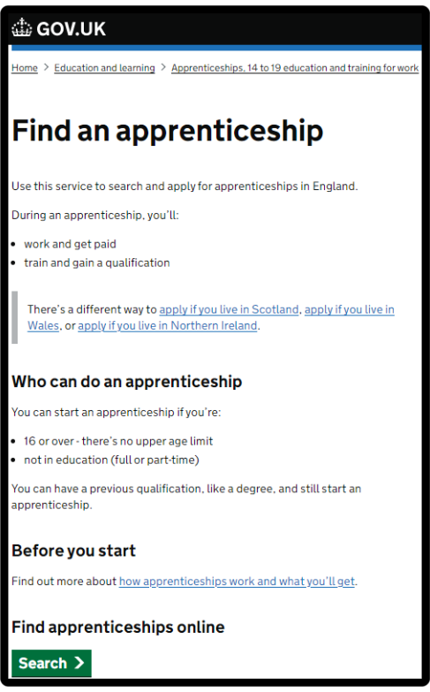





How do you find apprenticeships?
WHAT IS FAA?
Showcasing live apprenticeship jobs
20,000+ vacancies
over the year
Free to use
Secure site
Apply quickly
Notes:
Where did I find these vacancies? So one of the first places to look is Find an apprenticeship, the government portal for apprenticeship jobs.
It’s really important that you register. Search the internet for ‘Find an apprenticeship’ and it will come up as the first link.
The search page is on gov.uk, an official government site.
Have a look at the different jobs that are being advertised. Remember, this is a live jobs site so it may be that you need to try and few different searches or to broaden how far you are looking to find jobs that you are interested in. It also means different vacancies will come up at different times so do not be disheartened if you don’t find something straight away, you may want to look again at another time or on different jobs/employer websites.
Start applying for jobs that interest you. You need to remember that typically, some of the bigger companies will advertise quite early in the year (e.g. September/October) for apprentices to start the following September so please don’t leave it until the last minute or you might be disappointed to have missed a great opportunity.
Others may come up later in the year closer to the time you are looking to start your apprenticeship, so use the website to help you with the next step.
Set up your alerts. A great feature of this system is that you can get it to do all the hard work for you. You can manage your alert settings so that you receive emails when jobs come up that you might be interested in.
Employers are always telling us that the applicants that really stand out to them are those that have made a bit of extra effort. You could consider contacting the company and asking them if they have any virtual open days coming up, or work experience or other opportunities to engage with them. That will look really impressive on your application and can give you an advantage over other applicants.
Find an apprenticeship has some new features so we will be working with you to create an account / can share information about resources that will help you to set up an account.

Slide 11
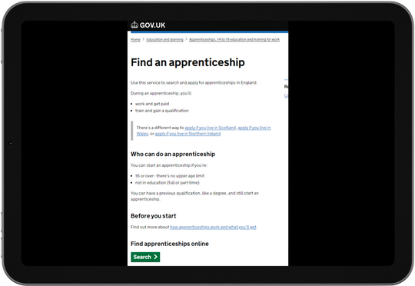



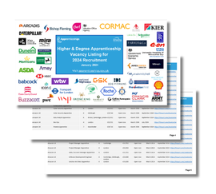

Where else to look
Find an apprenticeship
Local websites
Company websites
Careers websites
Social media
Friends and family
Higher and Degree listing
Notes:
Whilst Find an apprenticeship is a great place to start looking for apprenticeships, it is not the only place.
If you have a particular employer in mind, visit their website and see if you can sign up for recruitment alerts or if they send out a newsletter.
Make sure you follow their careers pages on social media using Facebook, Twitter and Instagram too as they will probably use this as a way to promote their vacancies. If you have a LinkedIn profile, it is worth following organisations on there as we have heard from many apprentices more recently that they have found vacancies from employers or training providers on LinkedIn. If you don’t yet have a profile, it may be worth exploring or asking for support in creating one from your school careers adviser or a parent/carer.
We have spoken to lots of apprentices and quite often, they will say that they actually heard about their job through a family member or friend. So make sure you tell everyone you can think of that you’re looking for an apprenticeship and you never know what might come through!
There are lots of other job search sites out there where you can flick through online profiles for some of the UK’s top apprentice employers.
Definitely spend some time looking into the different types of employers. There will be a real mix from your local council who might have a jobs page for young people, through to bigger recruitment sites too.
The Higher & Degree vacancy listing is also a really useful document that is shared in November and then an updated version is released again in February. This contains a list of hundreds of higher and degree apprenticeship vacancies that are open for application, and gives key information about the employer, the apprenticeship, the salary, location and where to apply. This will be shared on the Amazing Apprenticeships website and apprenticeships.gov.uk.

Slide 12

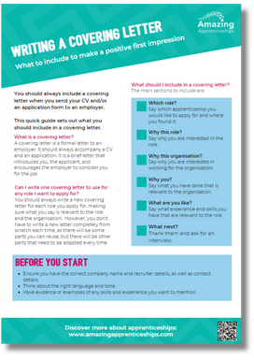
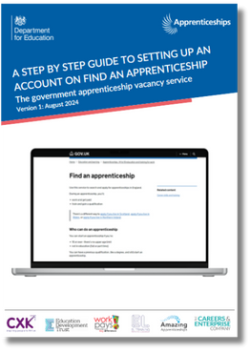
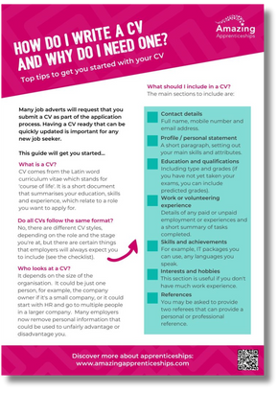
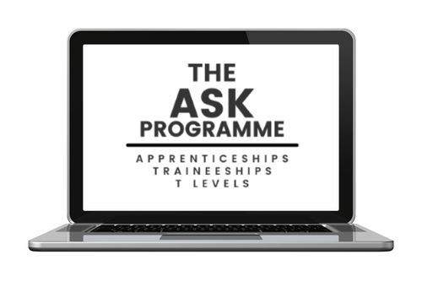



Useful websites & resources
Resources to support you in learning about apprenticeships
Application guides
Factsheets
Using Faa guide
Webinars
Employer profiles
Apprentice advice
www.amazingapprenticeships.com
Notes:
There are an array of resources that can support you in finding out more about apprenticeships.
You can visit Amazing Apprenticeships’ website to find useful:
- Application guides
- Factsheets and guides providing hints and tips
- A guide on how to use Find an apprenticeship and set up your account properly
- A range of webinars with experts and employers talking about apprenticeships, what’s available, explaining the different levels and opportunities and giving
application advice and guidance
- Profiles of top apprenticeship employers exploring what they offer and how to apply, with guidance from their recruitment teams
- Advice from apprentices through films, case studies and other resources

Slide 13
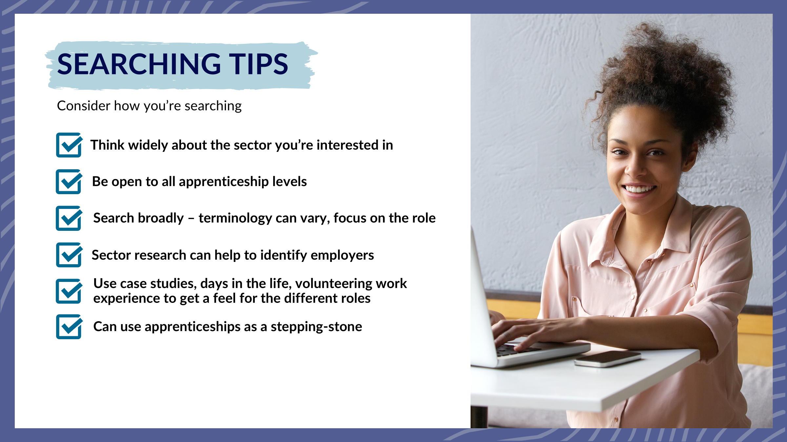
Useful websites & resources
Resources to support you in learning about apprenticeships
Application guides
Factsheets
Using Faa guide
Webinars
Employer profiles
Apprentice advice
www.amazingapprenticeships.com
Notes:
There are an array of resources that can support you in finding out more about apprenticeships.
You can visit Amazing Apprenticeships’ website to find useful:
- Application guides
- Factsheets and guides providing hints and tips
- A guide on how to use Find an apprenticeship and set up your account properly
- A range of webinars with experts and employers talking about apprenticeships, what’s available, explaining the different levels and opportunities and giving
application advice and guidance
- Profiles of top apprenticeship employers exploring what they offer and how to apply, with guidance from their recruitment teams
- Advice from apprentices through films, case studies and other resources

Slide 14
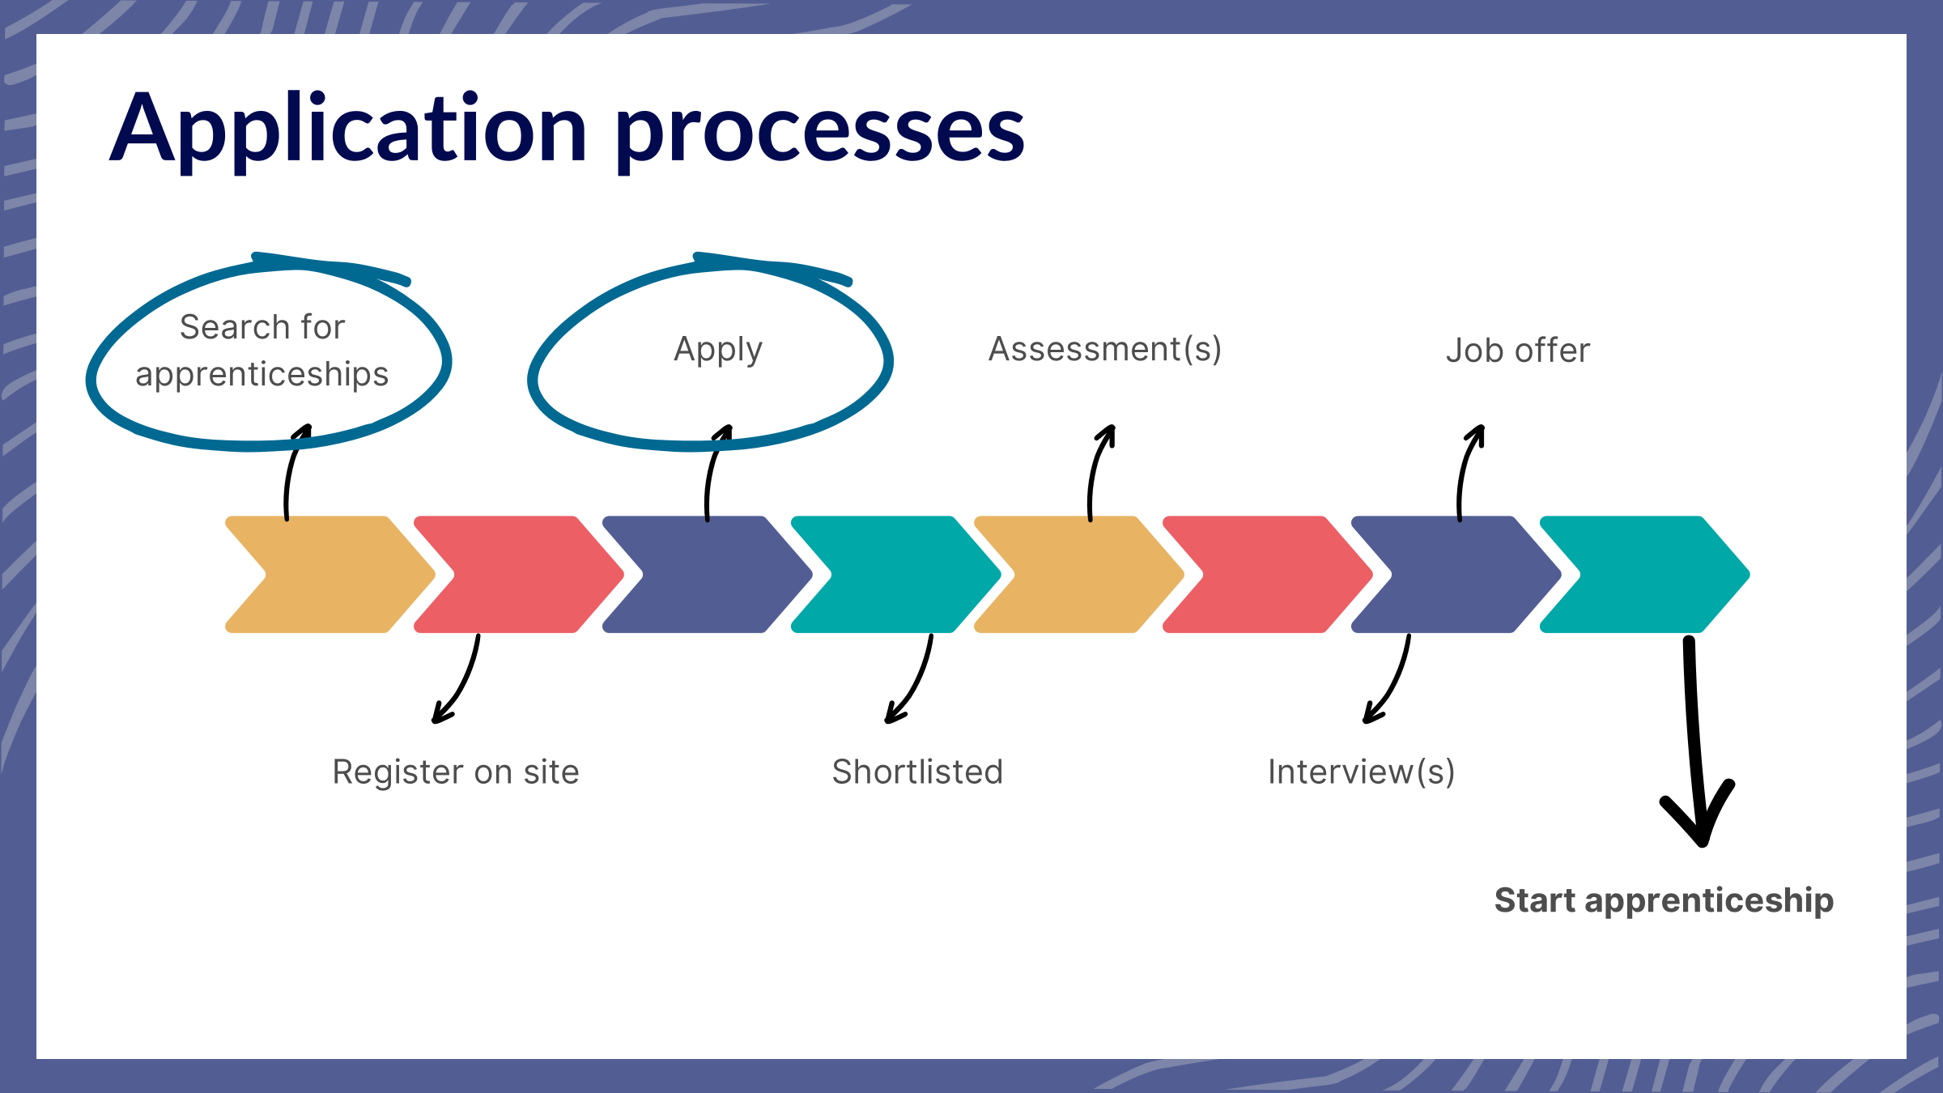
Useful websites & resources
Resources to support you in learning about apprenticeships
Application guides
Factsheets
Using Faa guide
Webinars
Employer profiles
Apprentice advice
www.amazingapprenticeships.com
Notes:
There are an array of resources that can support you in finding out more about apprenticeships.
You can visit Amazing Apprenticeships’ website to find useful:
- Application guides
- Factsheets and guides providing hints and tips
- A guide on how to use Find an apprenticeship and set up your account properly
- A range of webinars with experts and employers talking about apprenticeships, what’s available, explaining the different levels and opportunities and giving
application advice and guidance
- Profiles of top apprenticeship employers exploring what they offer and how to apply, with guidance from their recruitment teams
- Advice from apprentices through films, case studies and other resources

Slide 15
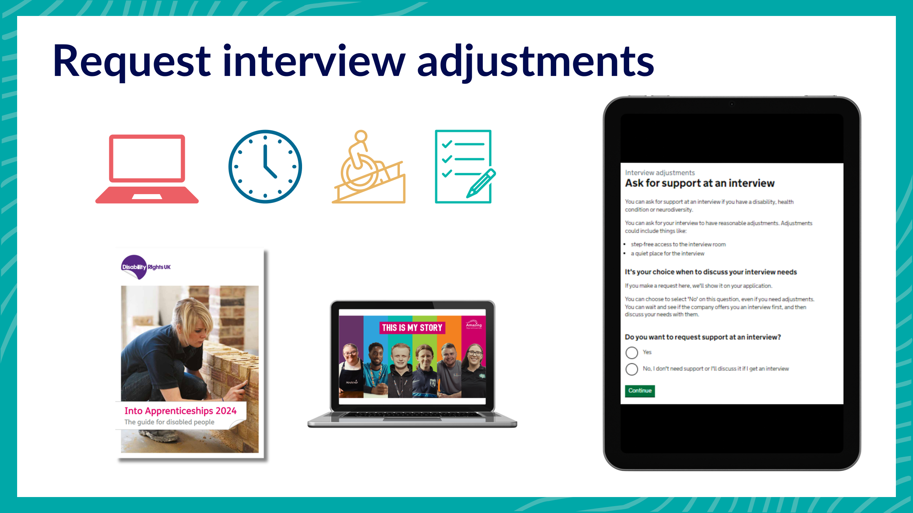
Useful websites & resources
Resources to support you in learning about apprenticeships
Application guides
Factsheets
Using Faa guide
Webinars
Employer profiles
Apprentice advice
www.amazingapprenticeships.com
Notes:
There are an array of resources that can support you in finding out more about apprenticeships.
You can visit Amazing Apprenticeships’ website to find useful:
- Application guides
- Factsheets and guides providing hints and tips
- A guide on how to use Find an apprenticeship and set up your account properly
- A range of webinars with experts and employers talking about apprenticeships, what’s available, explaining the different levels and opportunities and giving
application advice and guidance
- Profiles of top apprenticeship employers exploring what they offer and how to apply, with guidance from their recruitment teams
- Advice from apprentices through films, case studies and other resources

Slide 16
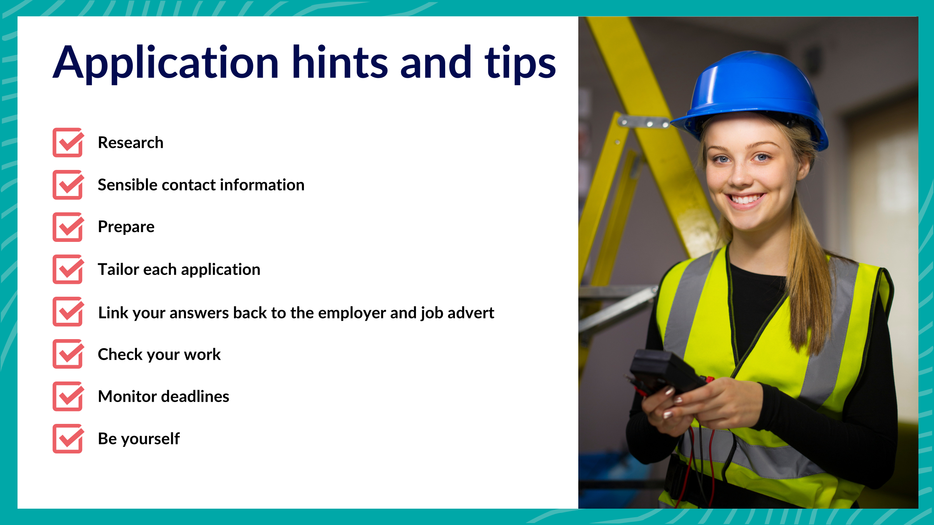
Useful websites & resources
Resources to support you in learning about apprenticeships
Application guides
Factsheets
Using Faa guide
Webinars
Employer profiles
Apprentice advice
www.amazingapprenticeships.com
Notes:
There are an array of resources that can support you in finding out more about apprenticeships.
You can visit Amazing Apprenticeships’ website to find useful:
- Application guides
- Factsheets and guides providing hints and tips
- A guide on how to use Find an apprenticeship and set up your account properly
- A range of webinars with experts and employers talking about apprenticeships, what’s available, explaining the different levels and opportunities and giving
application advice and guidance
- Profiles of top apprenticeship employers exploring what they offer and how to apply, with guidance from their recruitment teams
- Advice from apprentices through films, case studies and other resources

Slide 17


